Slide 1
Understanding the Business Cycle
Combining Aggregate Supply and Demand with LRAS
Inflationary Gaps
Recessionary Gaps

Slide 2
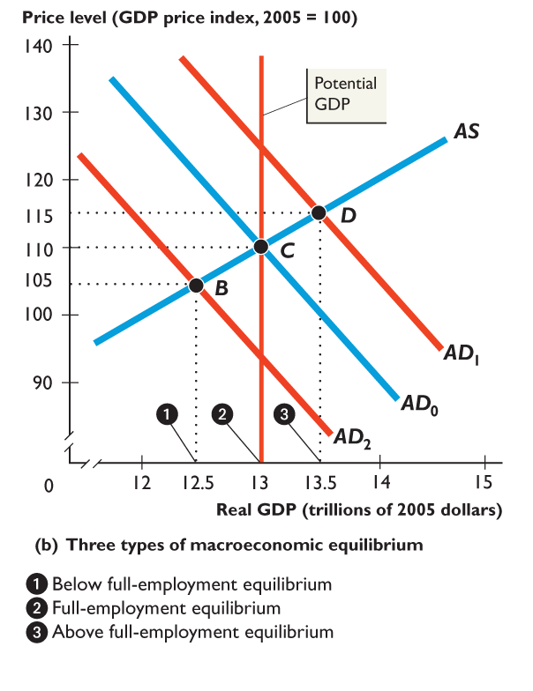
UNDERSTANDING THE BUSINESS CYCLE
Where AD and AS meet is considered to be Equilibrium GDP. There are 3 possible Macroeconomic Equilibriums:
Below Full Employment Equilibrium: when potential GDP exceeds equilibrium real GDP.
Full Employment Equilibrium: When potential GDP equals equilibrium Real GDP
Above Full Employment Equilibrium: when equilibrium real GDP exceeds potential GDP.

Slide 3
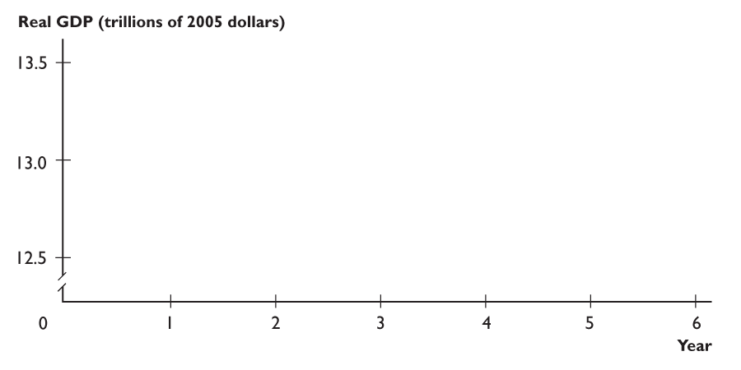
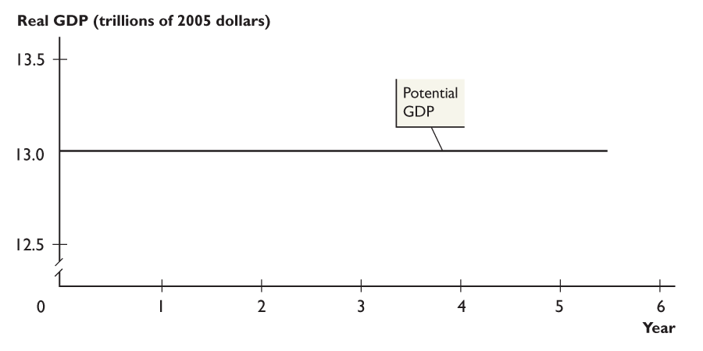
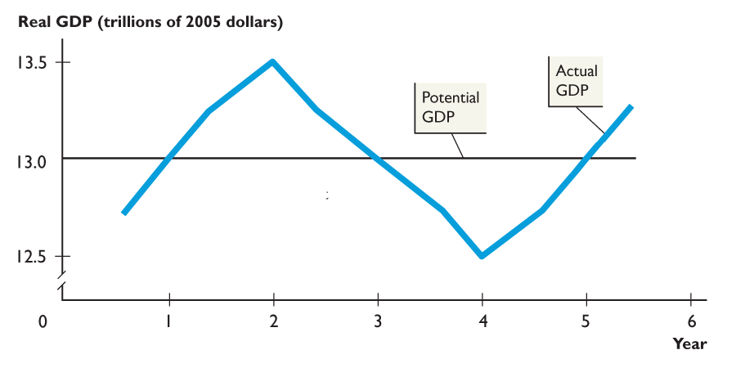
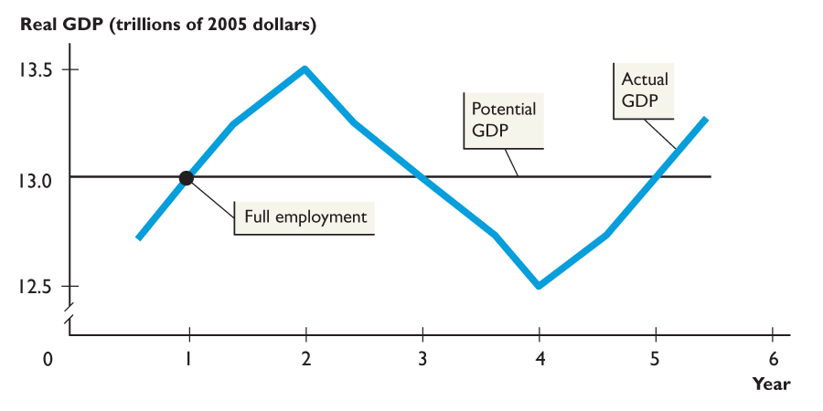
THE BUSINESS CYCLE - Output Gaps
Fluctuations in aggregate demand bring fluctuations in actual real GDP around potential GDP. Potential GDP = Full Employment
In year 1, real GDP equals potential GDP. The economy is at full employment.

Slide 4
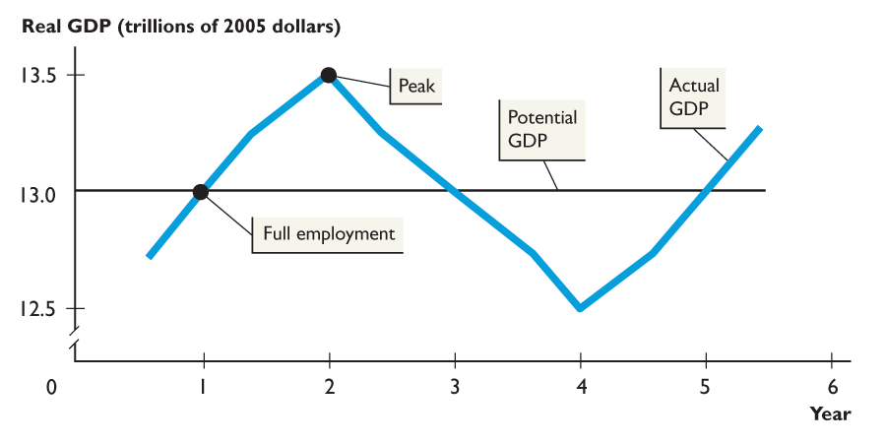
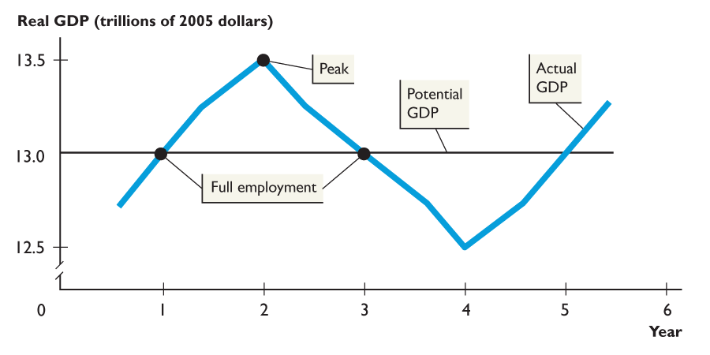
THE BUSINESS CYCLE – Output Gaps
In year 2, at a business cycle peak, real GDP exceeds potential GDP. The economy is operating at above full employment. (Inflationary Gap)
In year 3, real GDP equals potential GDP. The economy is back at full employment.

Slide 5
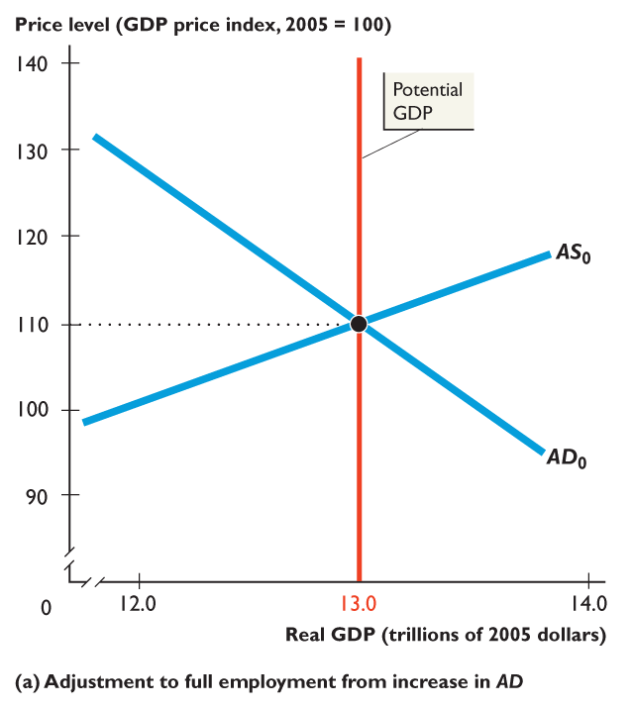
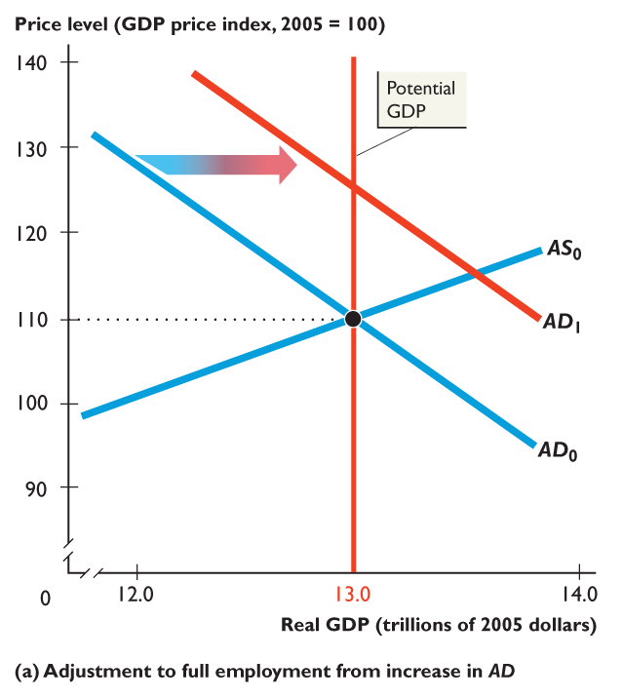
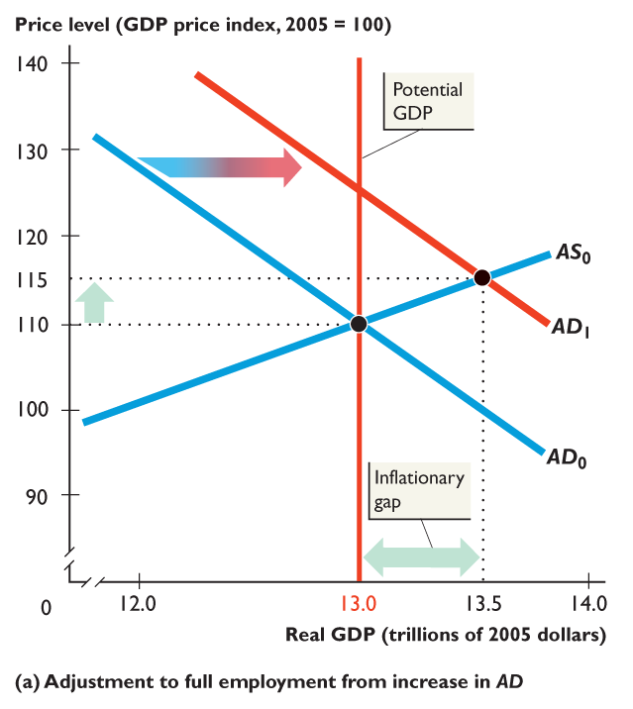
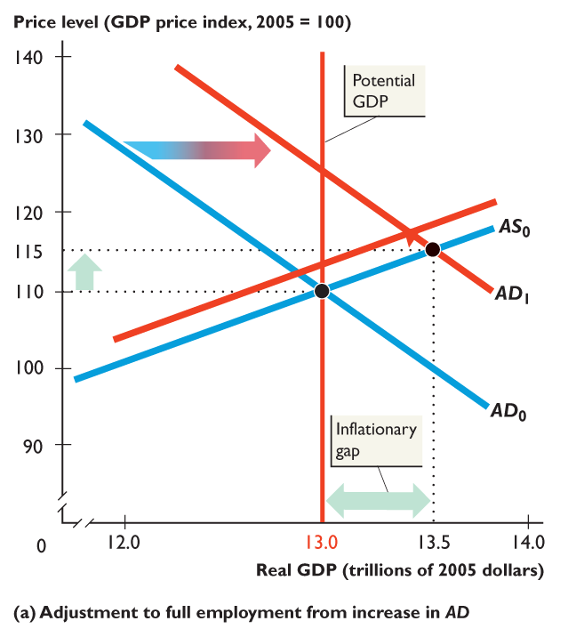
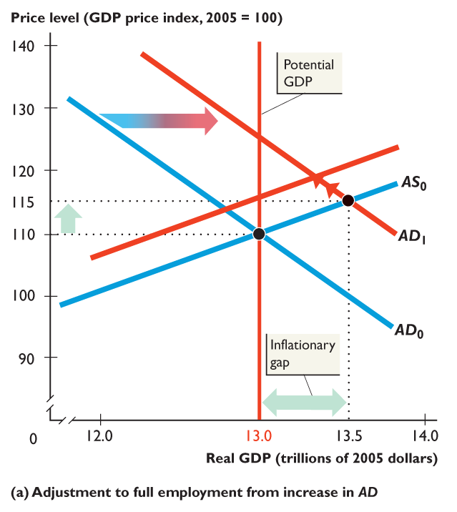
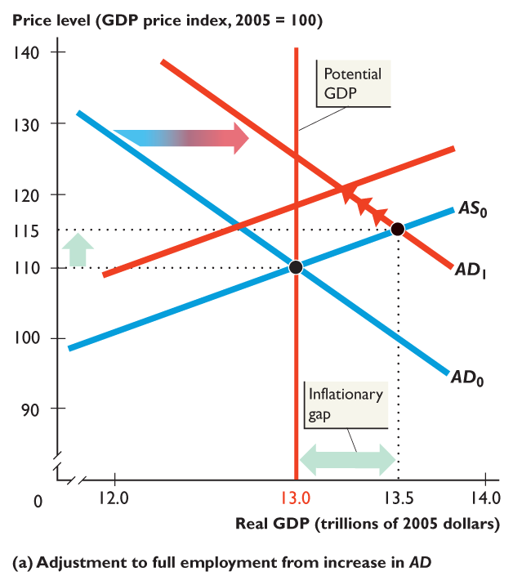
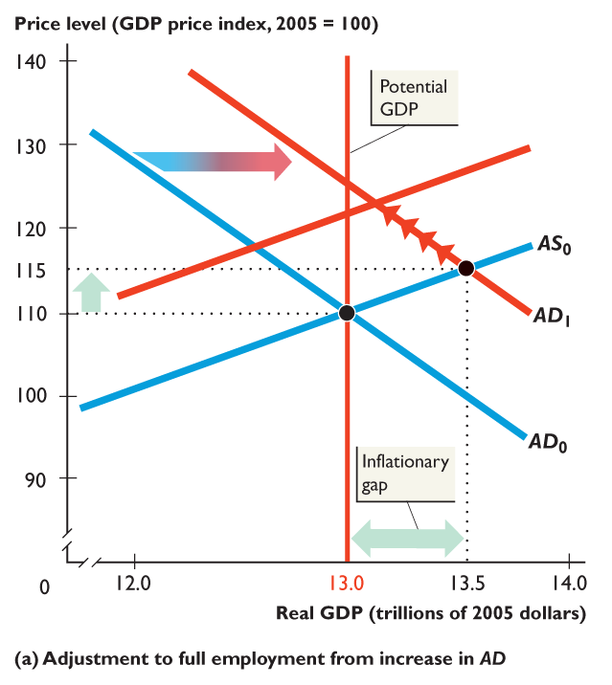
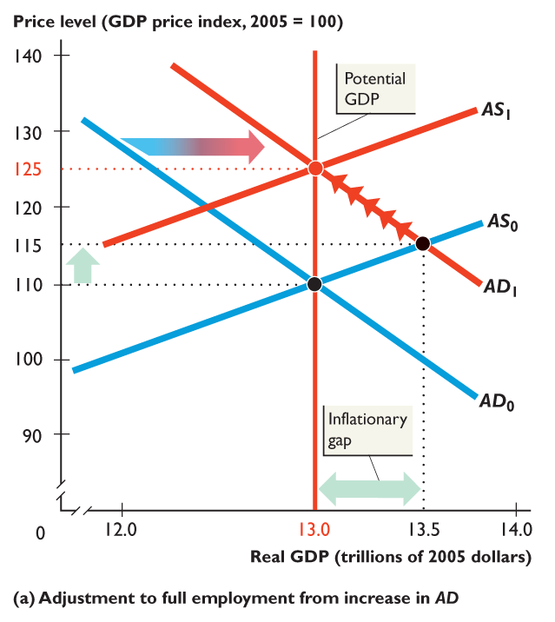
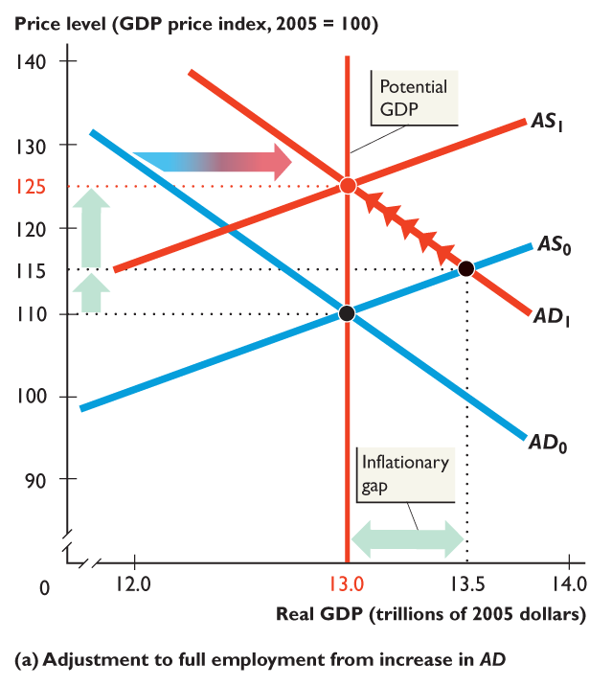
Inflationary Gap
The figure shows adjustments toward full employment.
Real GDP exceeds potential GDP — there is an inflationary gap —and the price level rises.
As the money wage rate gradually rises, aggregate supply decreases (cost of inputs), real GDP decreases, and the price level rises farther.

Slide 6
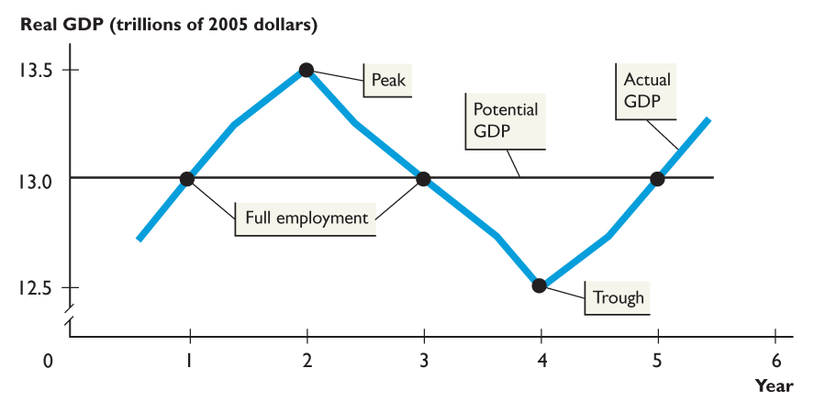
THE BUSINESS CYCLE – Output Gaps
In year 4, at a business cycle trough, real GDP is below potential GDP. The economy is operating at below full employment. (Recessionary Gap)
In year 5, real GDP equals potential GDP. The economy is back at full employment.

Slide 7
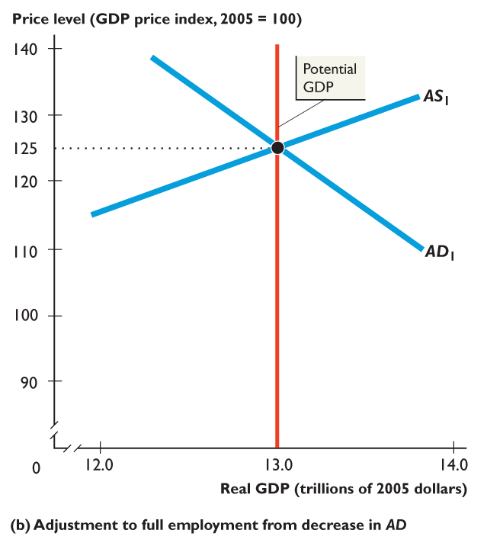
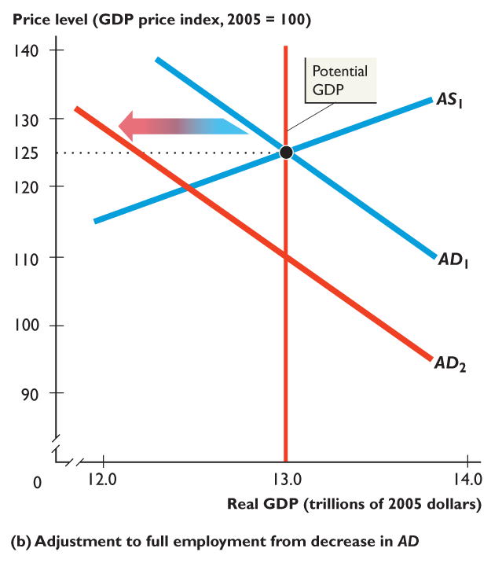
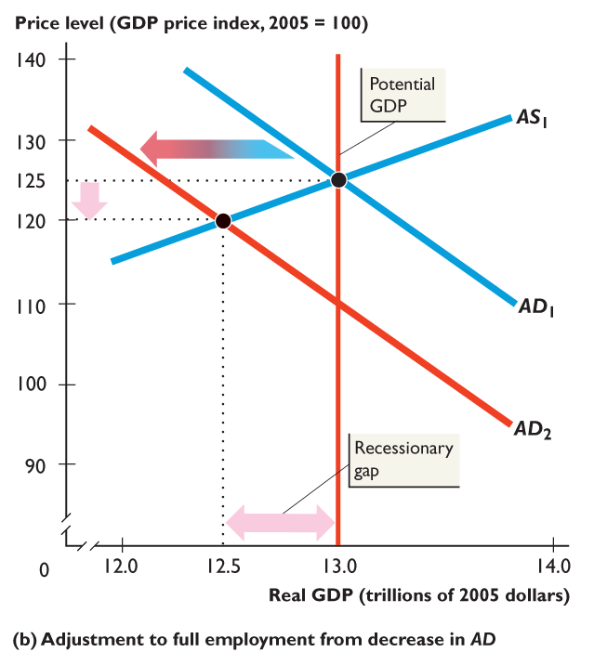
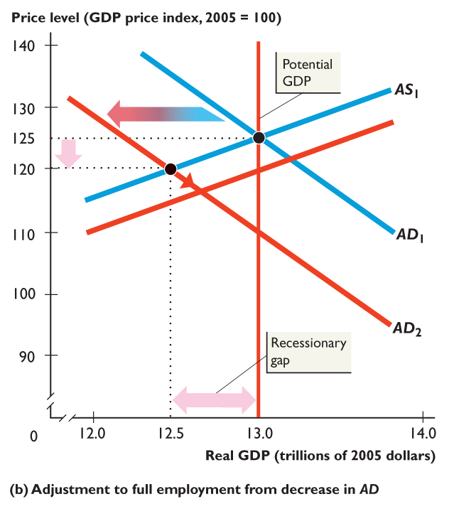
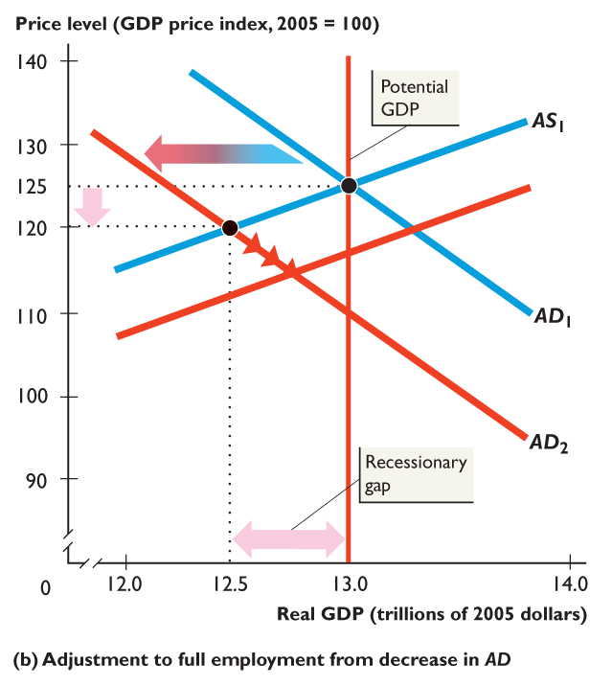
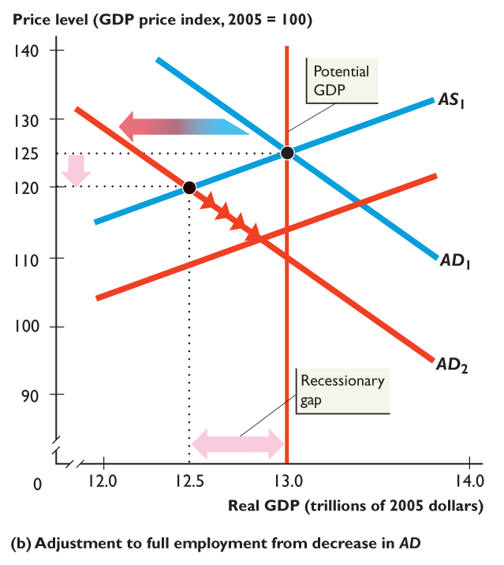
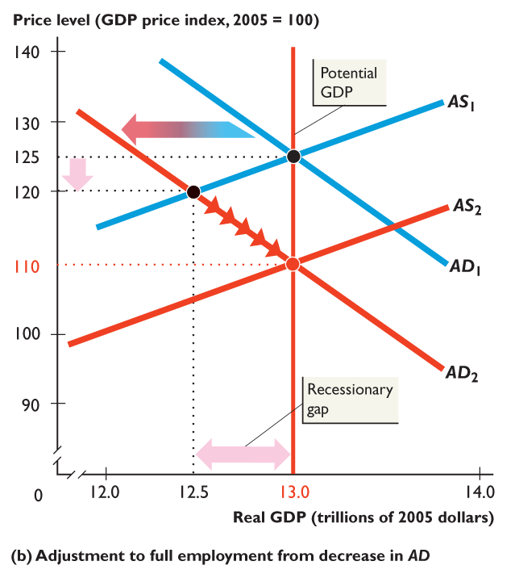
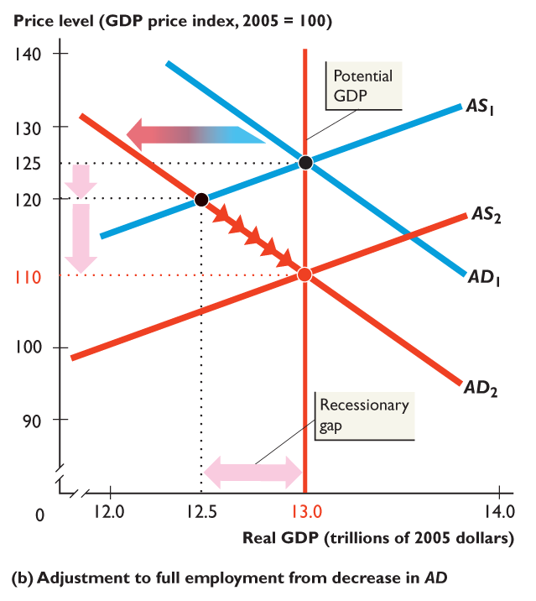
Recessionary Gap
Potential GDP exceeds real GDP—recessionary gap— and the price level falls.
Eventually, the money wage rate starts to fall, aggregate supply increases (cost of inputs), real GDP increases, and the price level falls farther.

Slide 8
Inflationary and Recessionary Gaps
Adjustment Toward Full Employment
When the economy is away from full employment, forces operate to restore full employment. This is what we practiced yesterday… (if AS shifts rightward, how will we get back to long-run equilibrium?)
Inflationary gap is a gap that exists when real GDP exceeds potential GDP and that brings a rising price level.
Recessionary gap is a gap that exists when potential GDP exceeds real GDP and that brings a falling price level.
Notes:
Reinforce the movement toward long-run equilibrium with a curve-shifting exercise. Take the case where the AD curve shifts rightward. The fact that the initial equilibrium occurs where the new AD curve intersects the AS curve is not difficult. But the notion that the AS curve shifts leftward as time passes is difficult for many students. The trick to making this idea clear is to spend enough time when initially discussing the AS curve so that the students realize that wages and other input prices remain constant along an AS curve. Once the students see this point, they can understand that, as input prices increase in response to the higher level of prices, the AS curve shifts leftward. Avoid confusing students by using ‘up’ to correspond to a decrease in aggregate supply. But do point out that that when the AS curve shifts leftward it is moving vertically upward, as input prices rise to become consistent with potential GDP and the new long-run equilibrium price level. Most students find it easier to see why the AS curve shifts leftward once they see that rising input prices shift the curve vertically upward

Slide 9
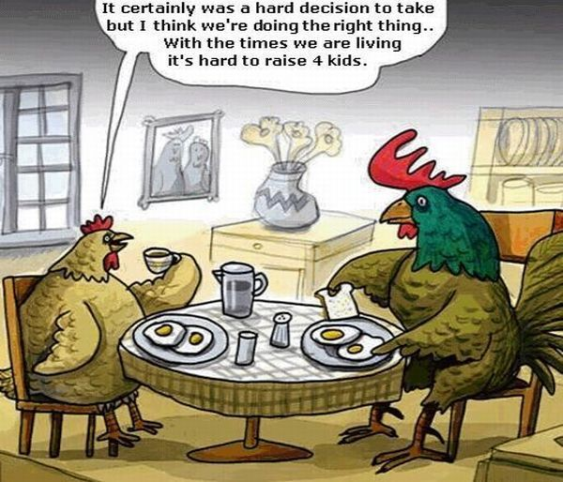
Aggregate Supply Fluctuations
Aggregate Supply Fluctuations
Aggregate supply fluctuates for two types of reasons:
Potential GDP grows at an uneven pace.
The money price of a major resource, such as crude oil, might change.
Stagflation is a combination of recession (falling real GDP) and inflation (rising price level).

Slide 10
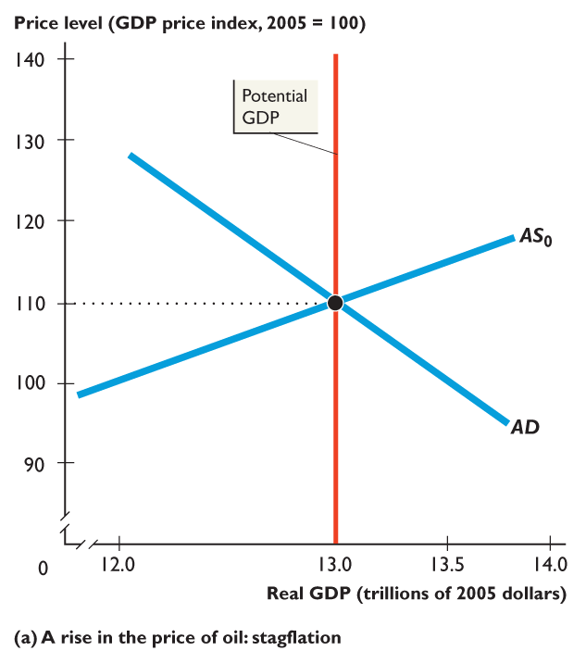
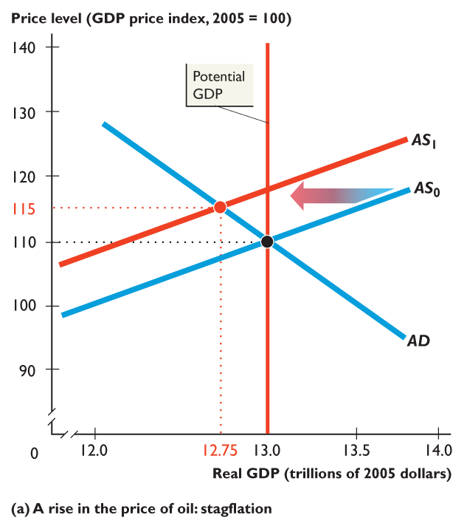
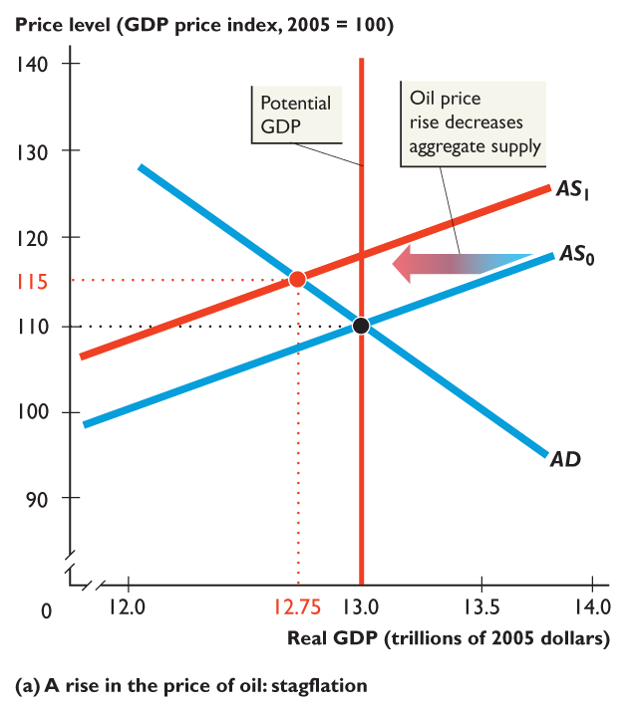
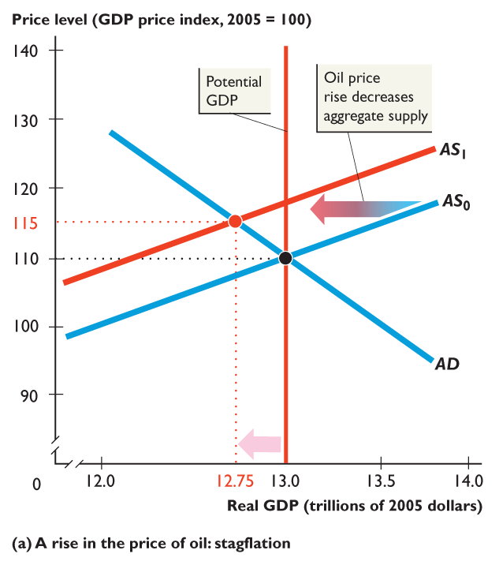
Stagflation
Figure 28.10 shows an oil price cycle.
A rise in the price of oil decreases aggregate supply and shifts the AS curve leftward to AS₁.
Real GDP decreases, and the price level rises.
The economy experiences stagflation.

Slide 11
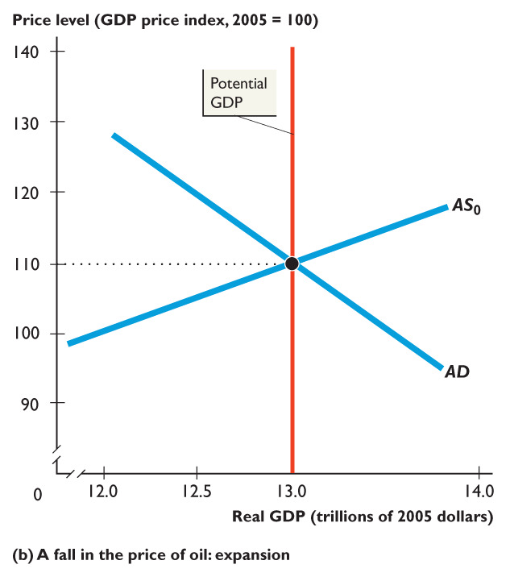
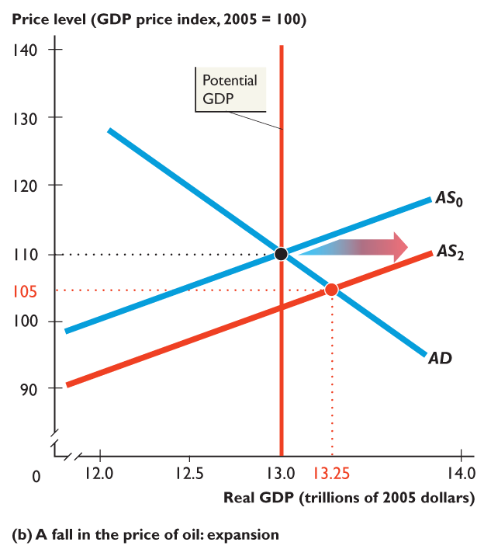
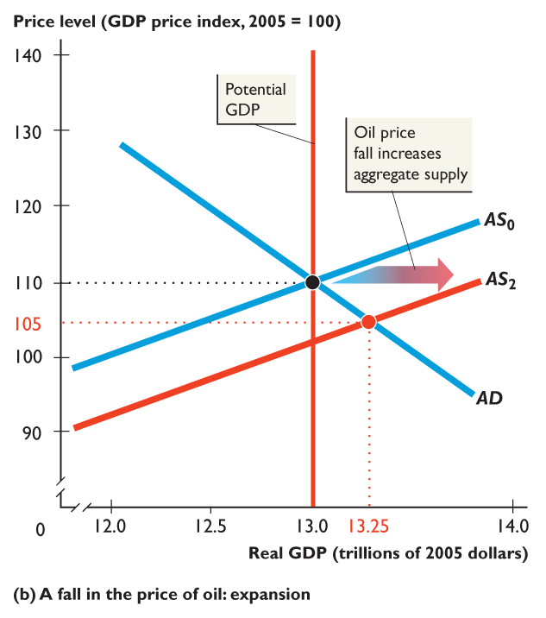
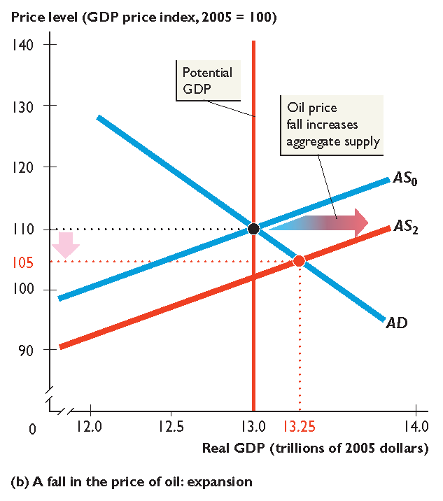
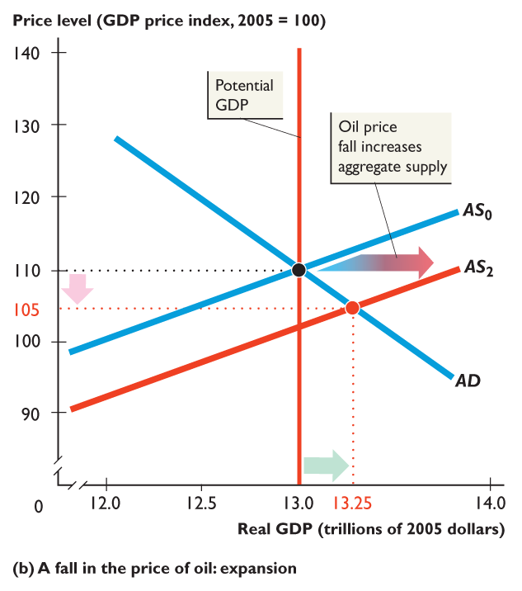
Expansion – AS Increase
A fall in the price of oil increases aggregate supply and shifts the AS curve rightward to AS₂.
The price level falls and real GDP increases.
The economy experiences an expansion.

Slide 12
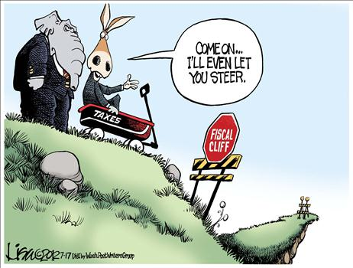
Fiscal Policy – Impacts on the Gaps
Fiscal Policy: Deliberate changes in government spending and taxation to achieve full employment, control inflation and encourage growth.
Expansionary Fiscal Policy: Fiscal Policy enacted in order to increase aggregate demand and expand real output.
Contractionary Fiscal Policy: Fiscal Policy enacted in order to decrease aggregate demand and control inflation.

Slide 13
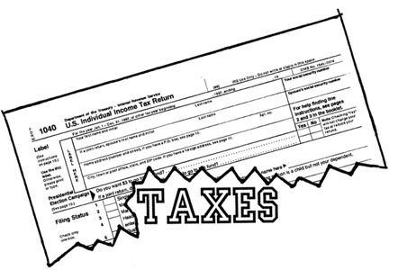
Expansionary Policies
1. Increased Government Spending
2. Tax Reductions
3. Combo of 1 &2

Slide 14
Contractionary Policies
1. Decrease Government Spending
2. Increase Taxation
3. Combo of 1 & 2

